Slide 1
Final Portfolio
Josh Adams
CS6475 - Fall 2019

Slide 2
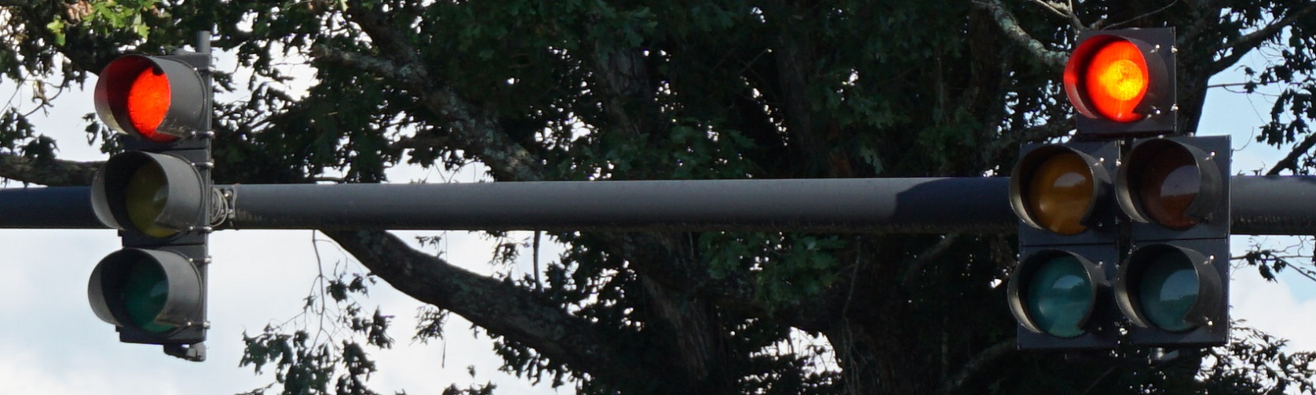
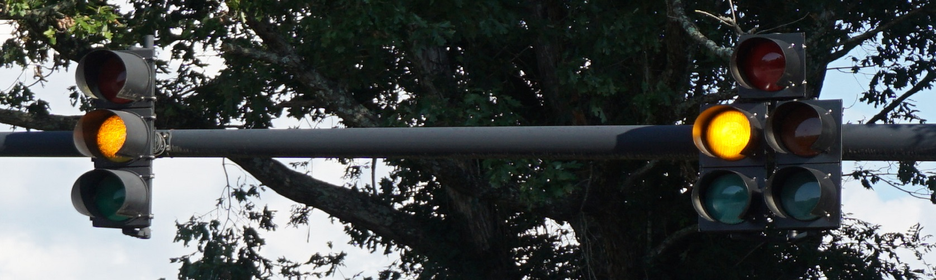
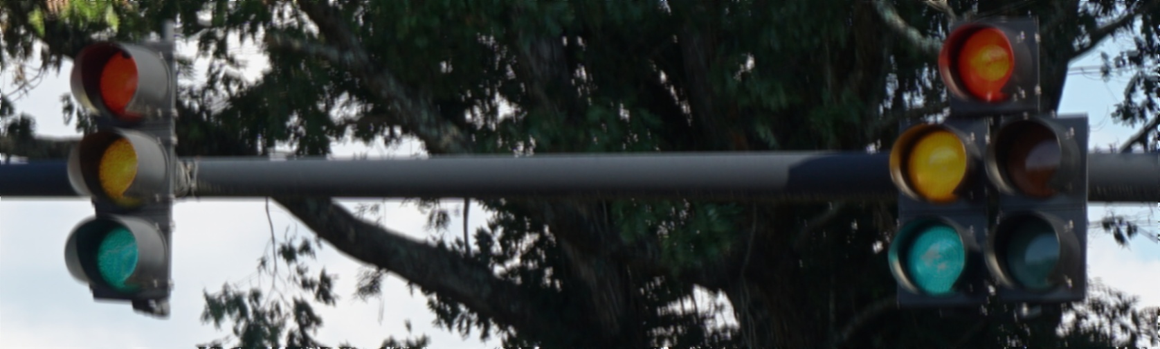
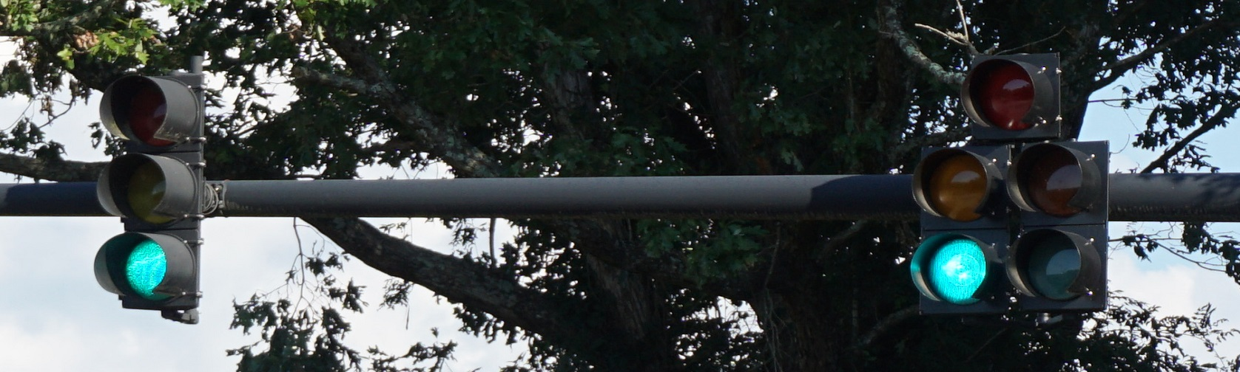
Assignment #1: Epsilon Photography
Epsilon photography was an assignment where we controlled all aspects of an image sequence, except for one small setting or detail. In this sequence the only thing that changed was the light. I then processed that sequence to remove those changes and that results in a final image with all the lights turned off.

Slide 3
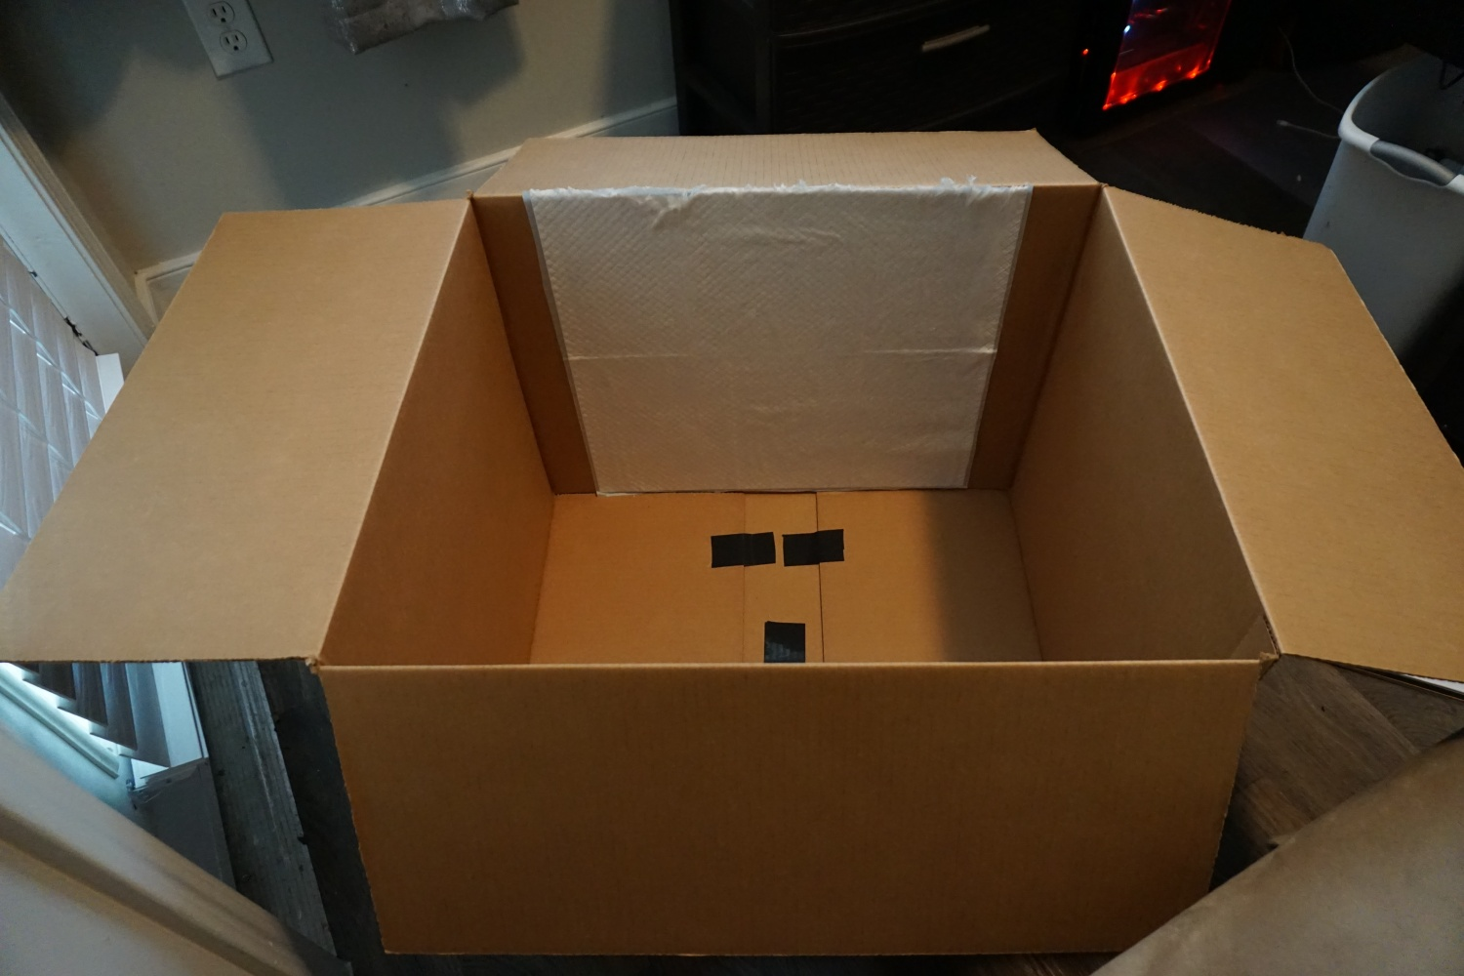
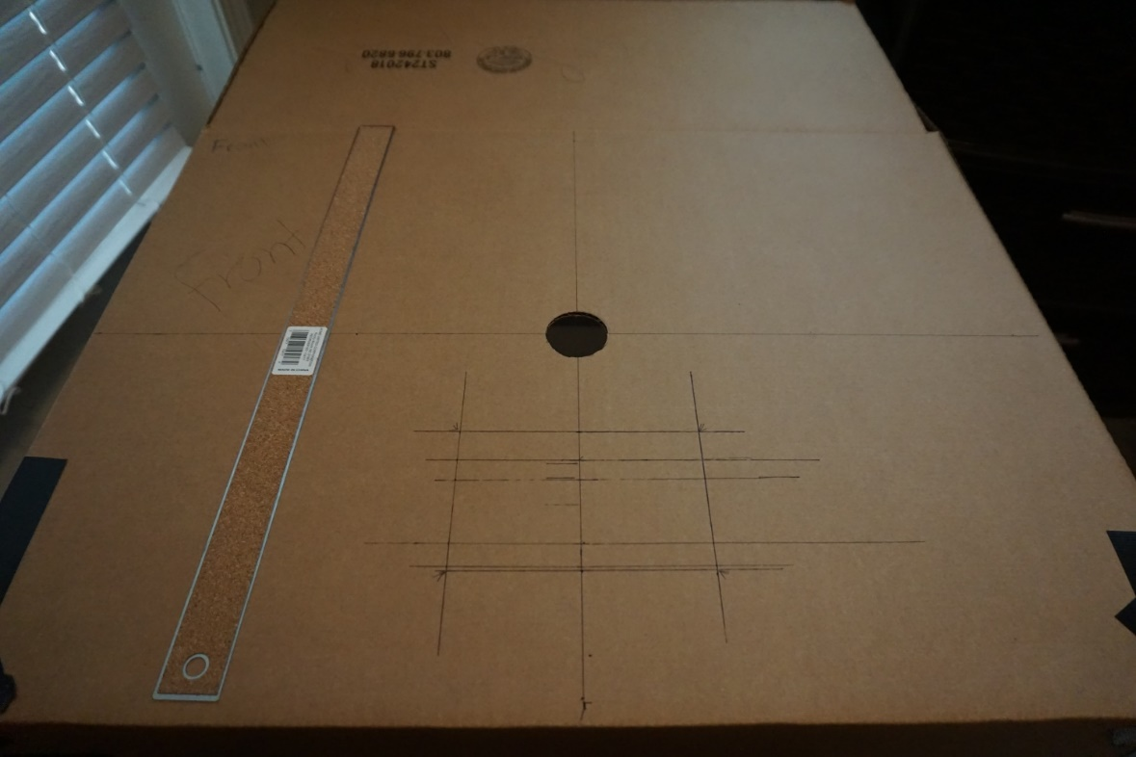
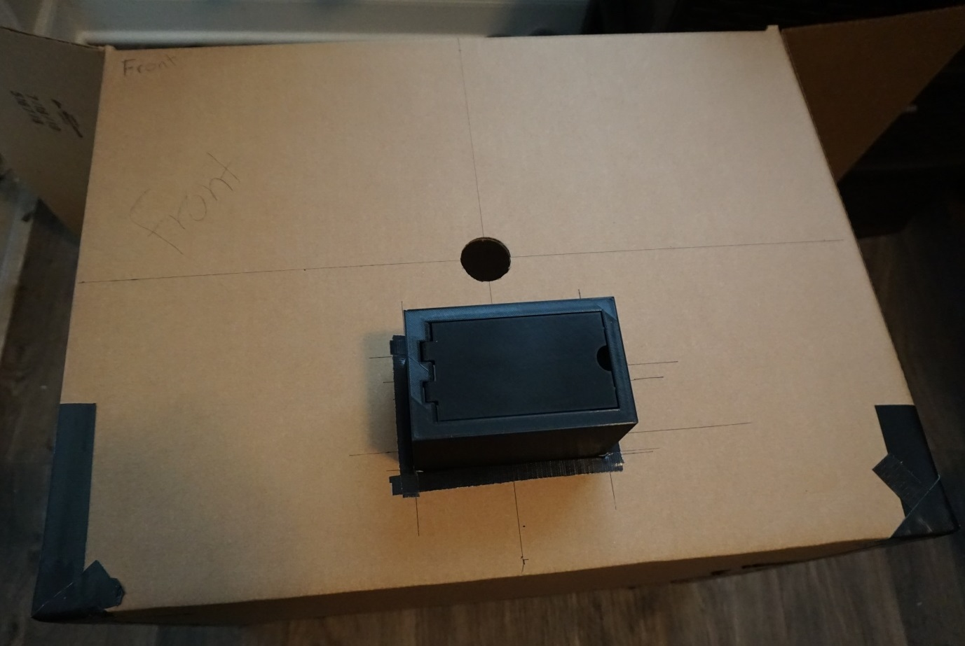
Assignment #2: Camera Obscura
This assignment was to create a camera obscura. I did this by taking a cardboard box, sealing the box so no light may enter. I then cut a specifically sized hole in the box, as to put one of the various sized apertures that I printed into it. This will allow me to control the amount of light that enters the box and allows me to try to produce better results by varying the size of the aperture.

Slide 4
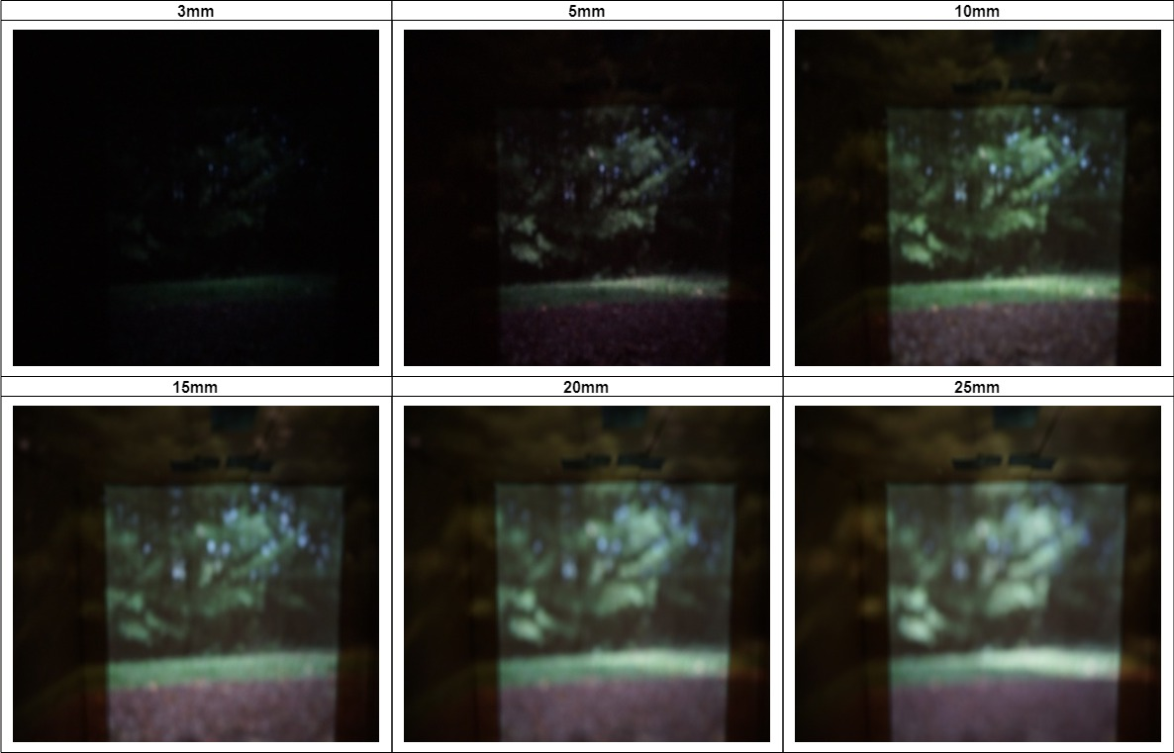
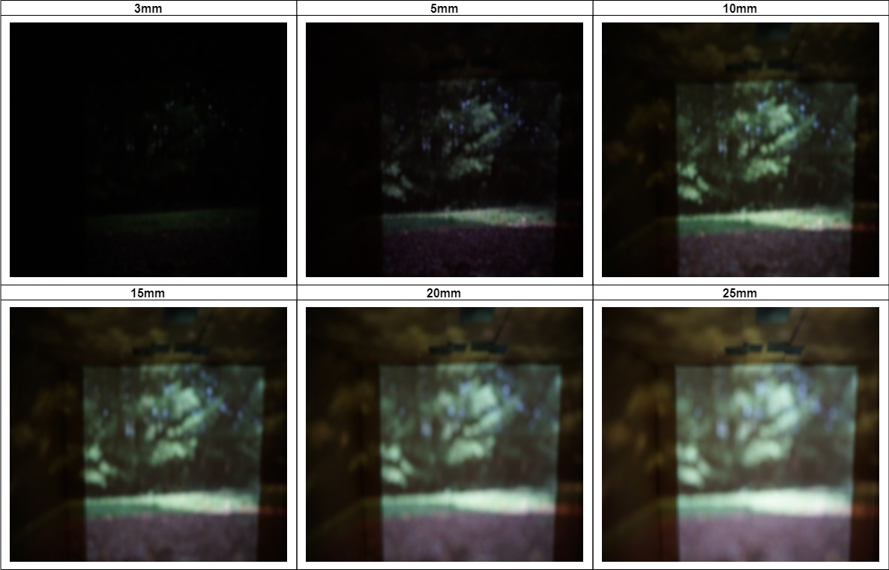
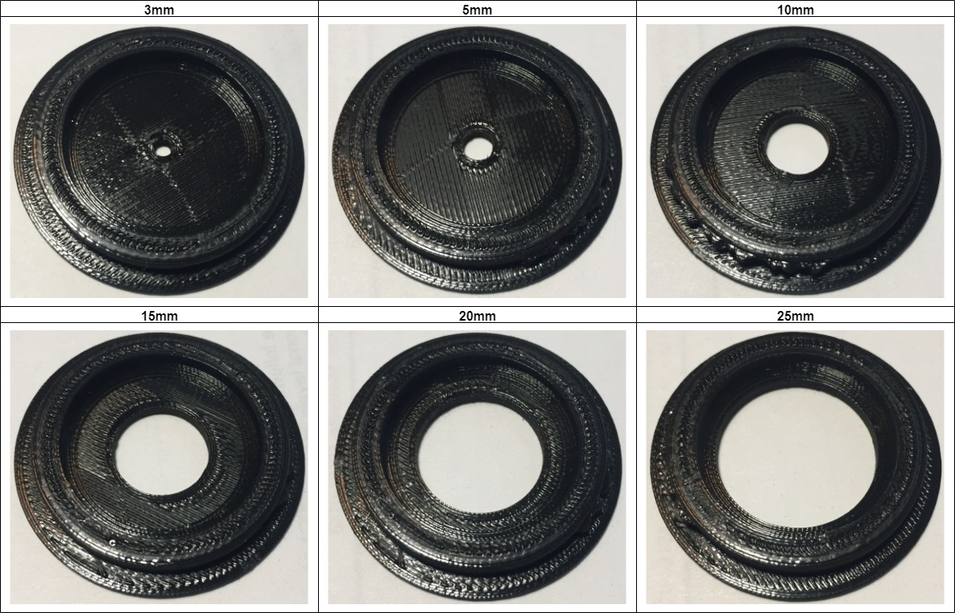
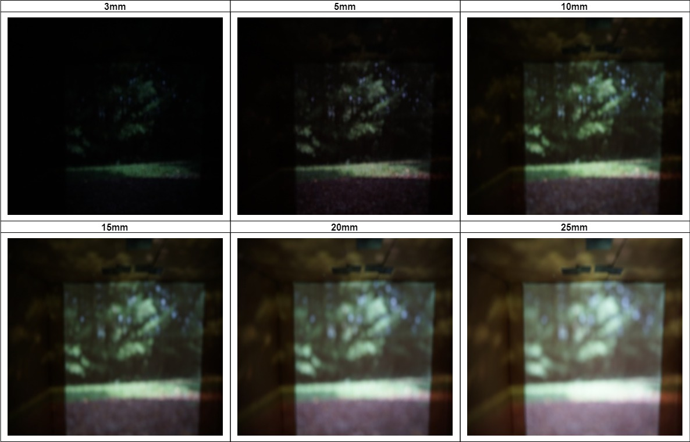
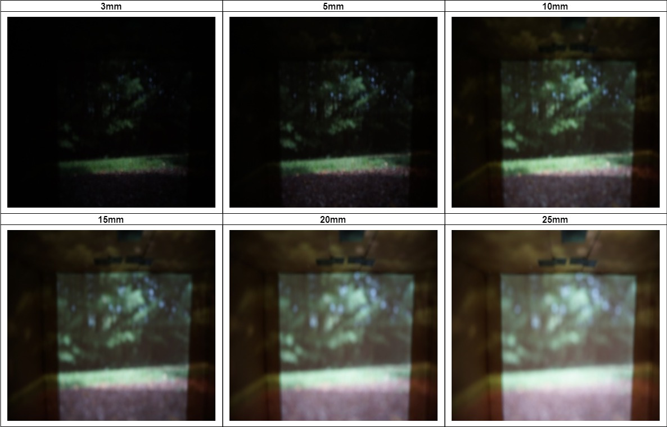
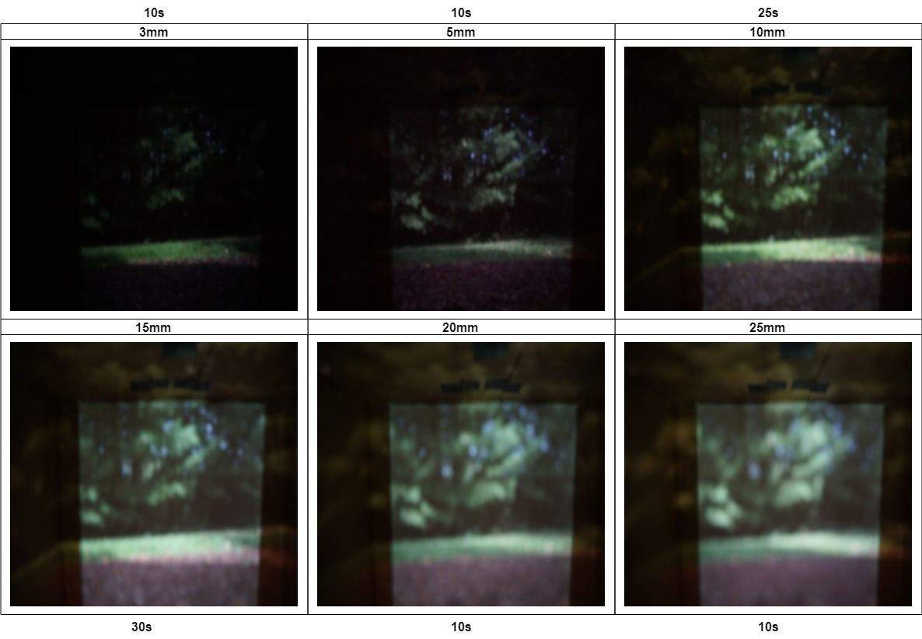
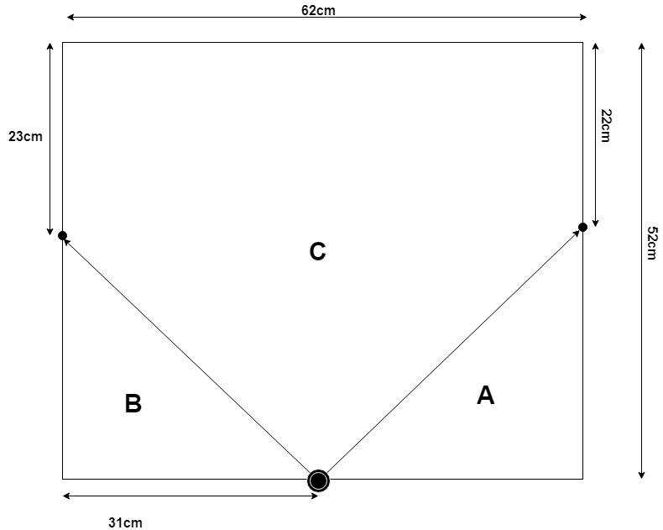
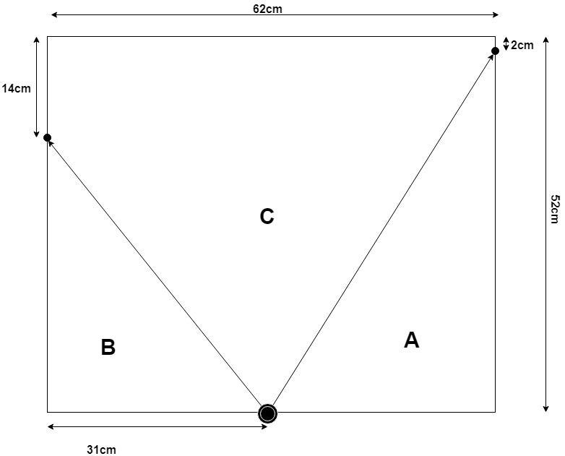
Assignment #2: Camera Obscura
Varying the exposure time
Pinhole sizes
Best Results

Slide 5
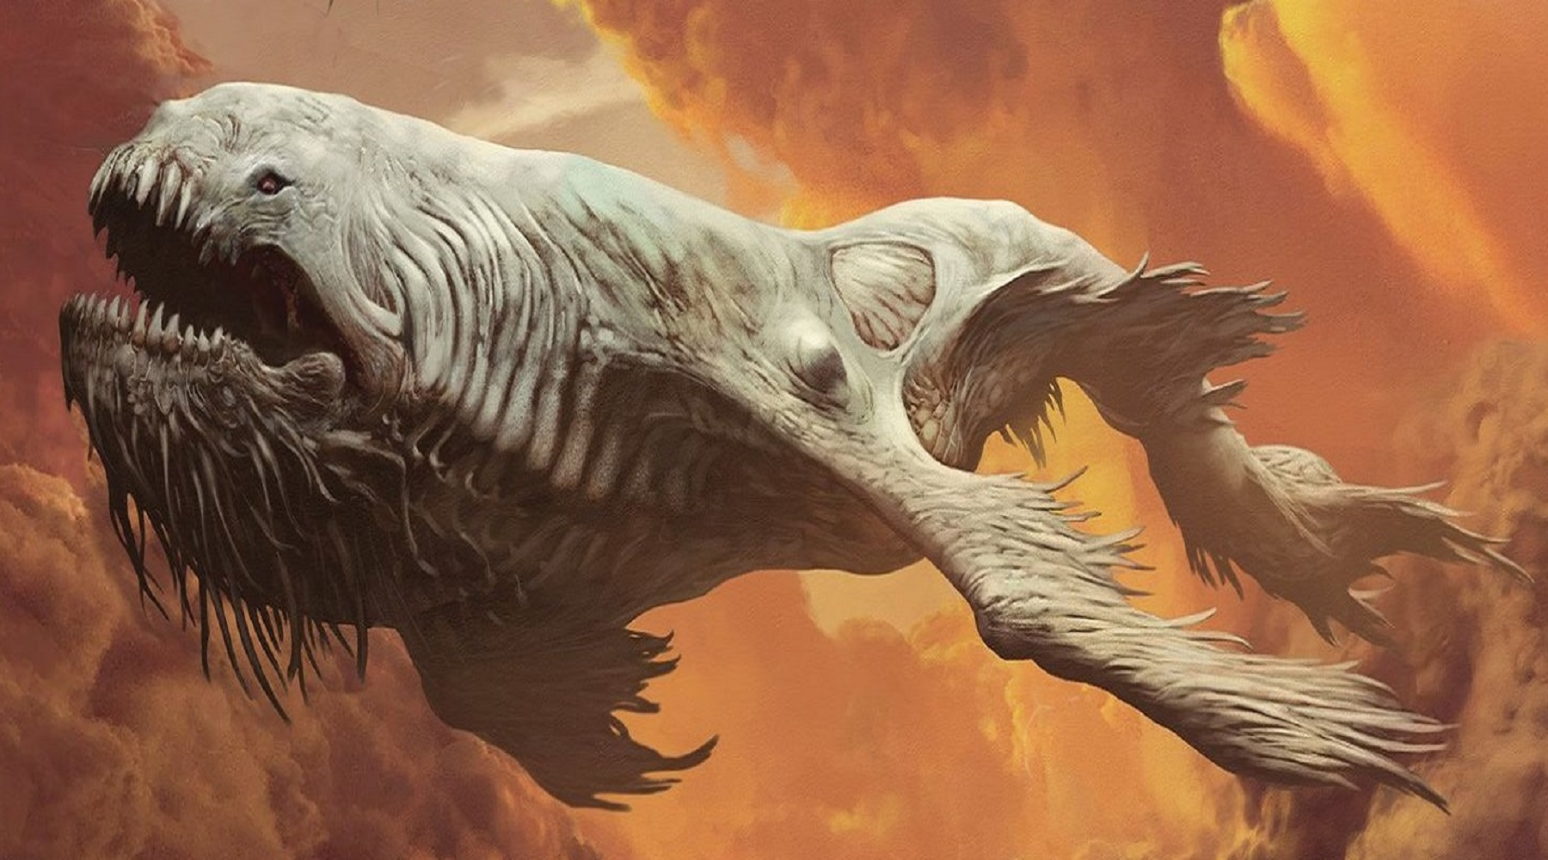
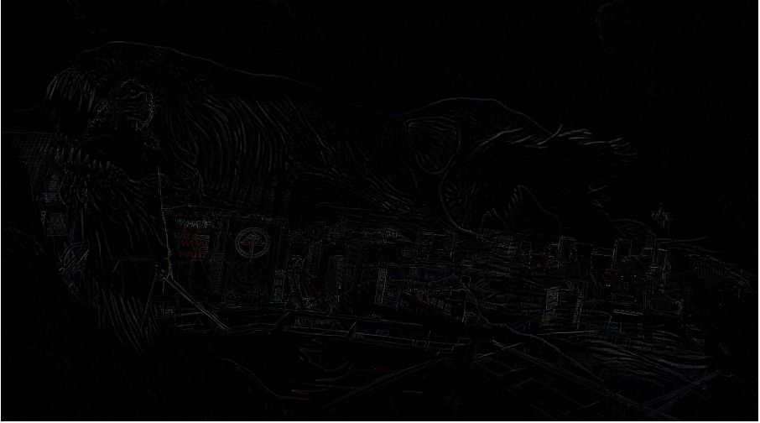
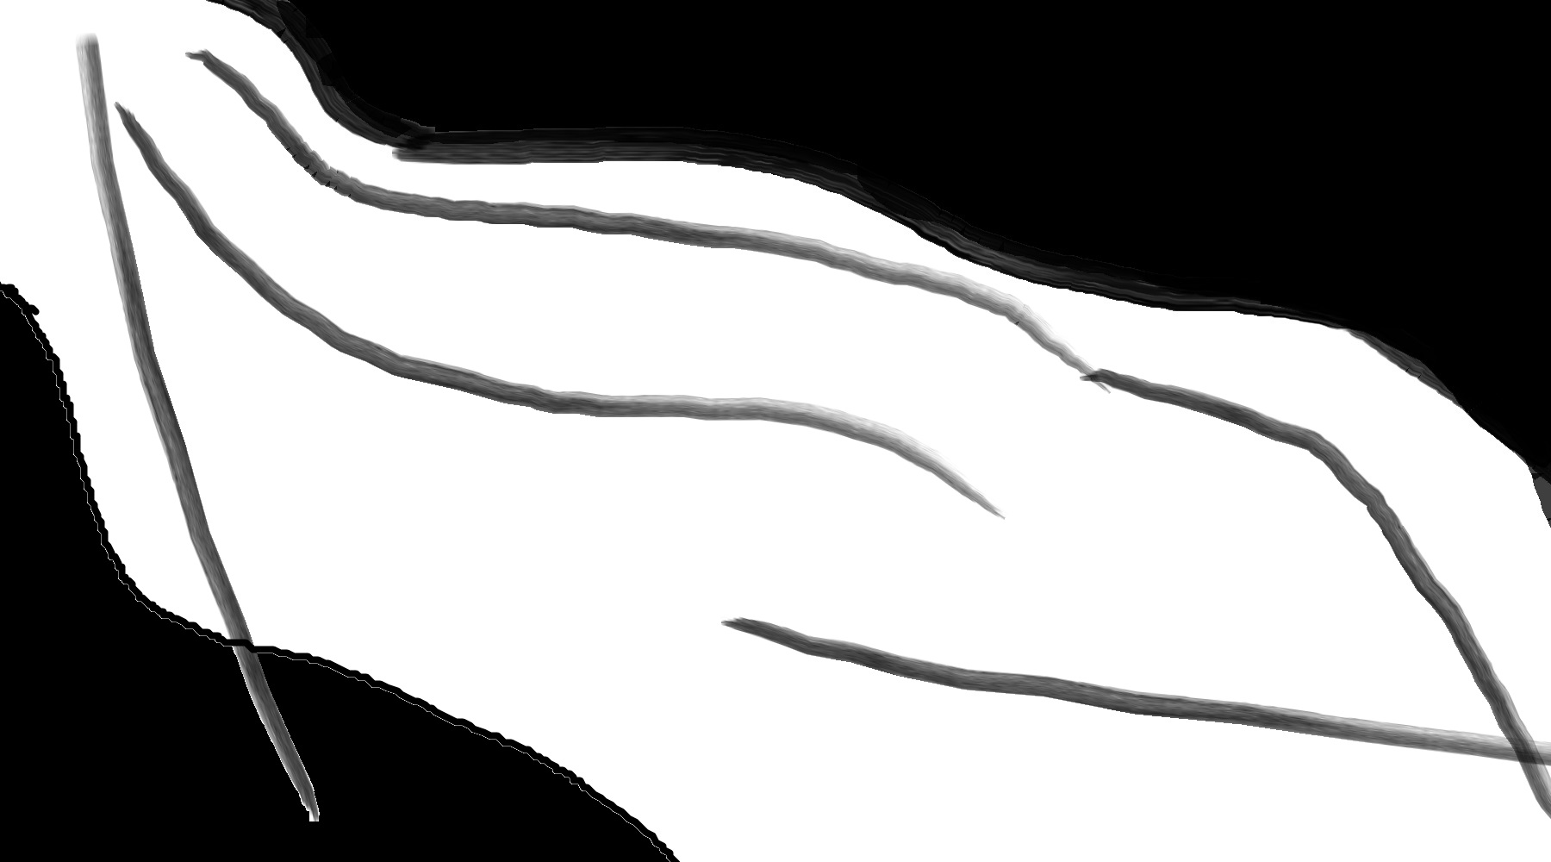
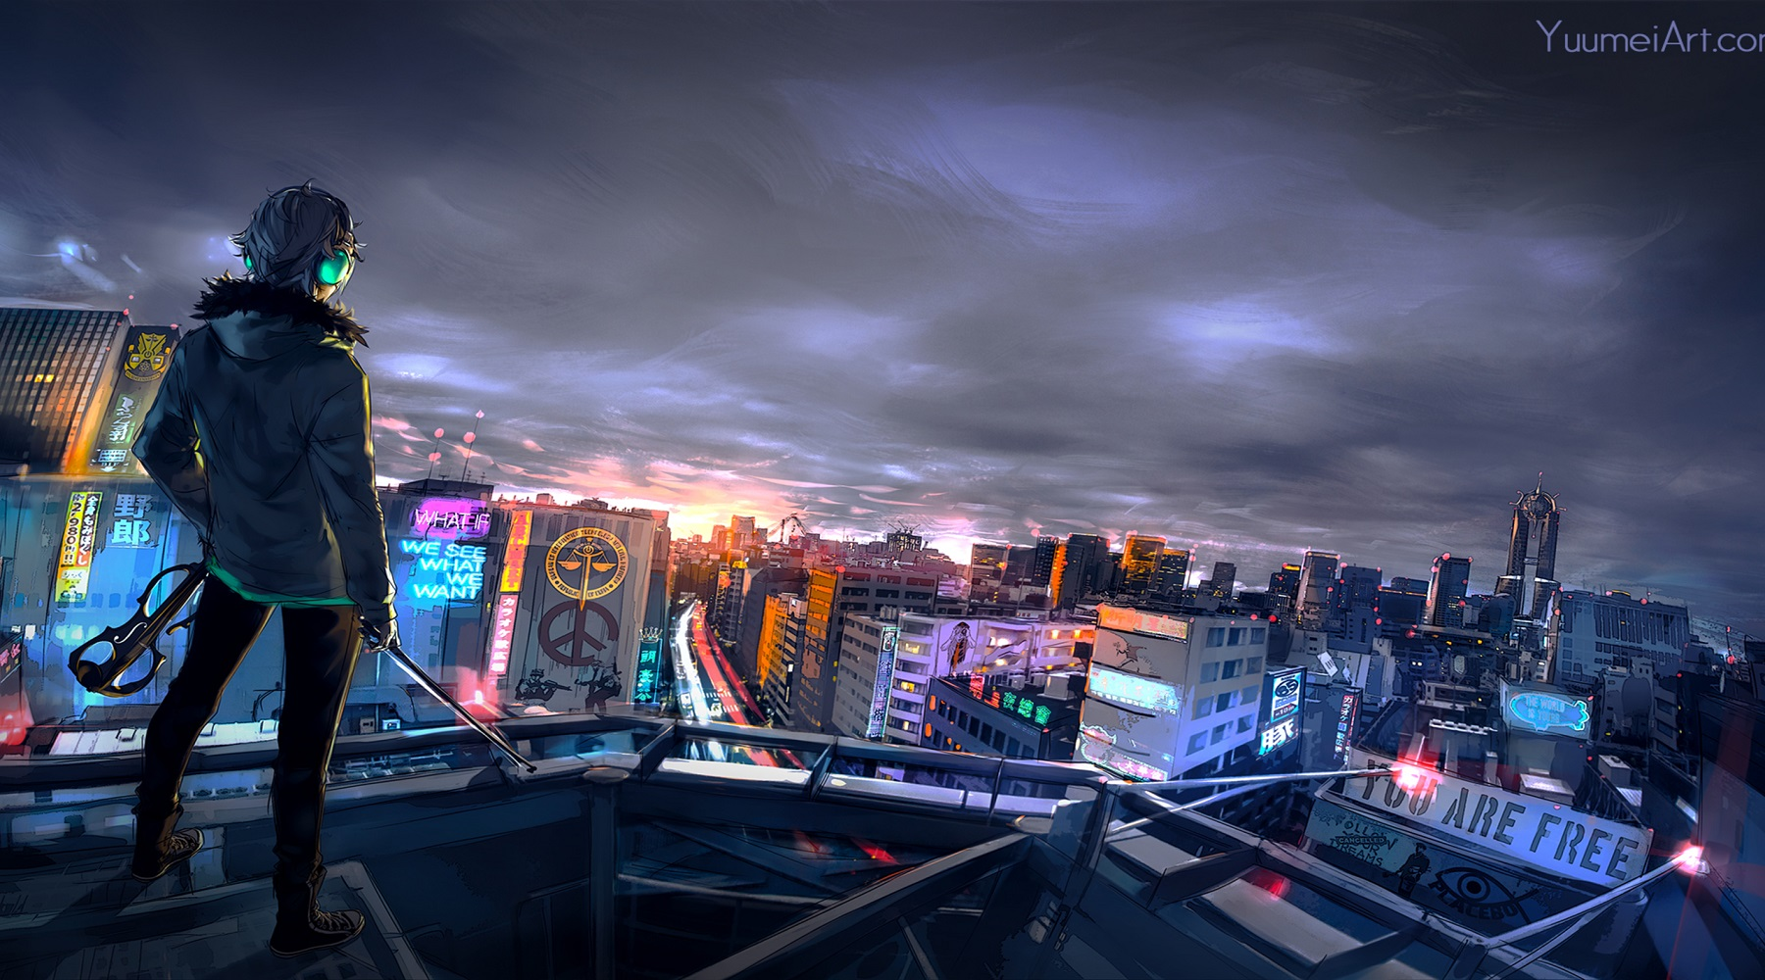
Assignment #3: Blending
The blending assignment was to attempt and blend two images together using a generated mask.
Image 1
Mask
Image 2
Result

Slide 6
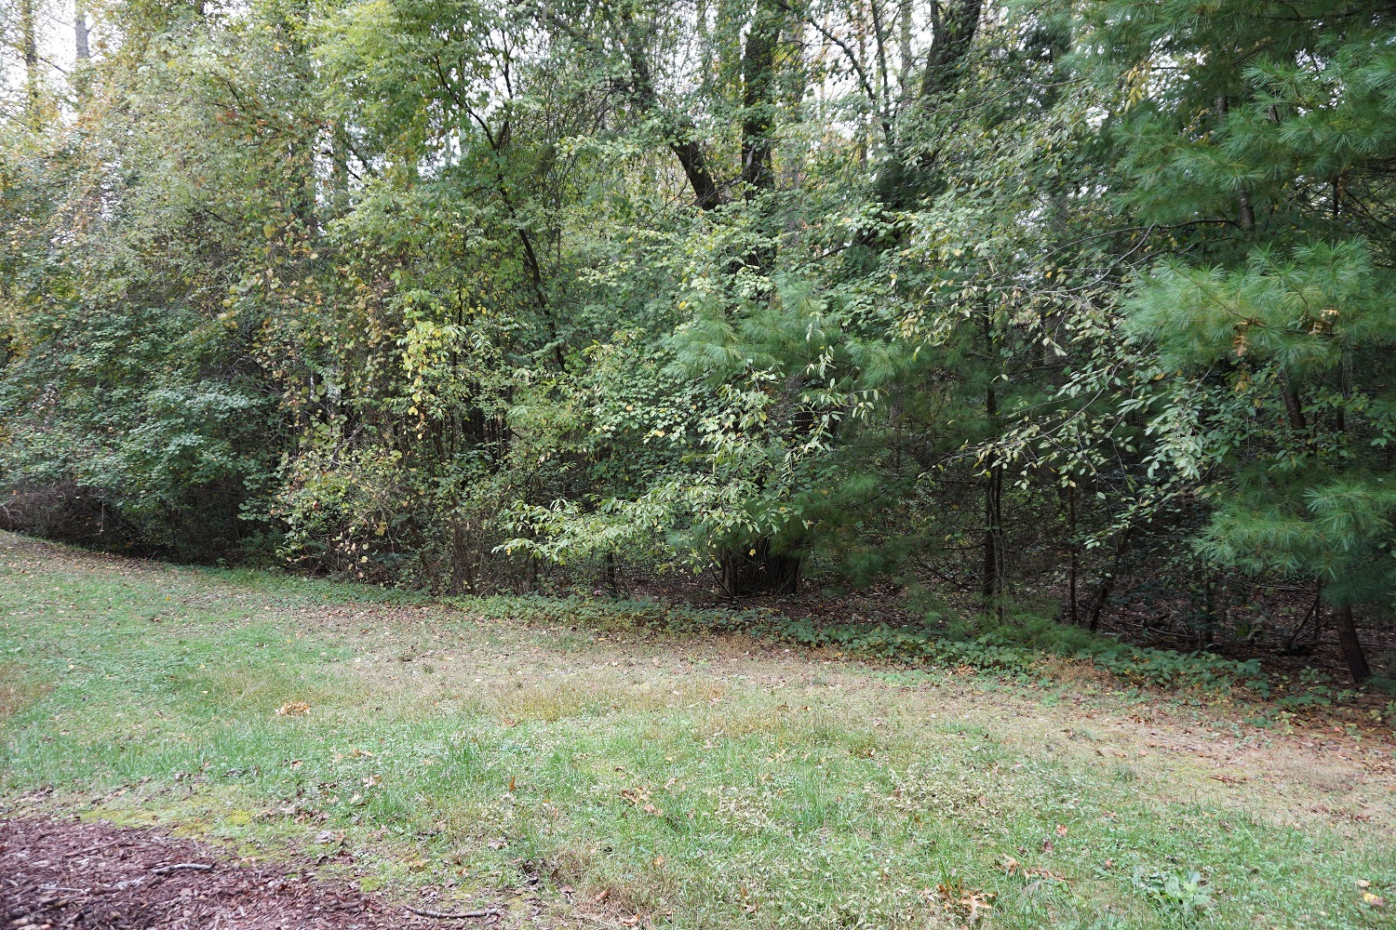
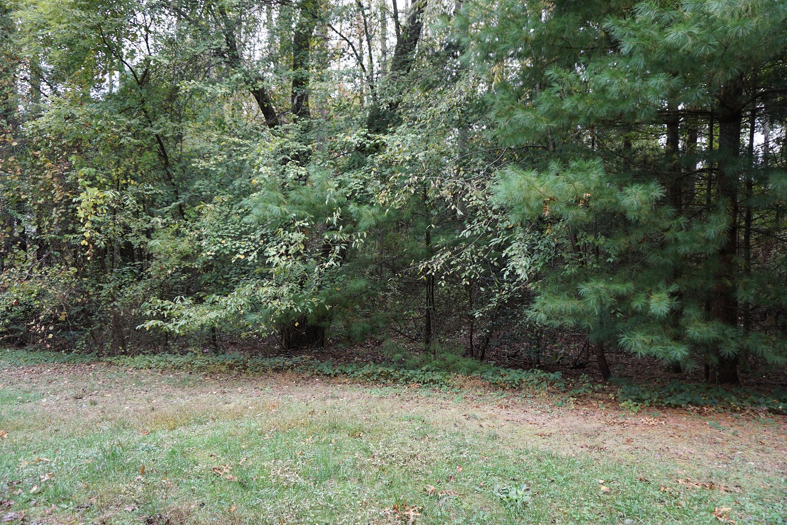
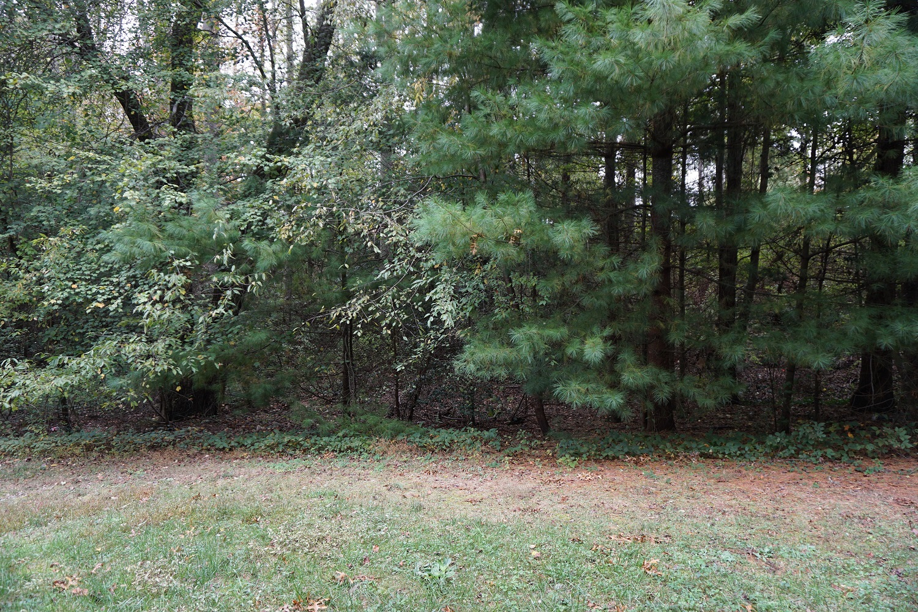
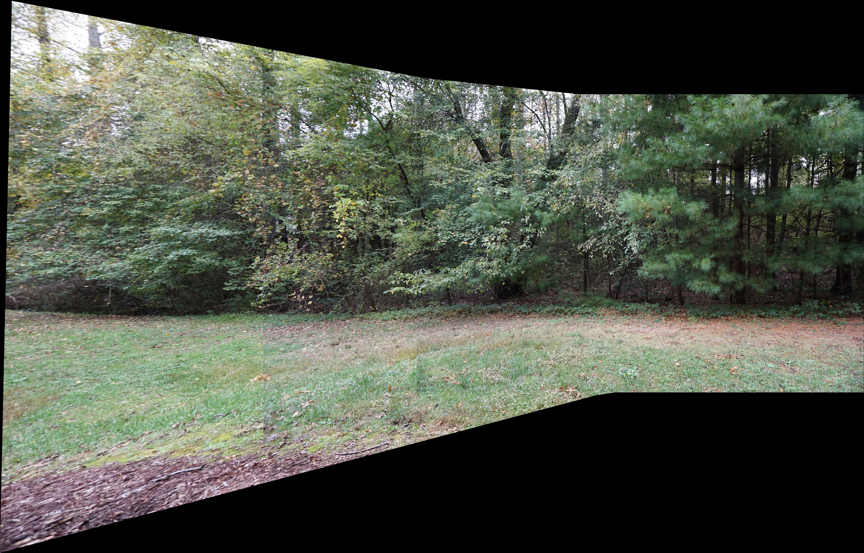
Assignment #4: Panoramas
Input Image 1
Input Image 2
Input Image 3
The goal of this assignment was to produce a panorama. I took three images from the backyard of my apartment. I combined those images to produce the resulting panorama.
Result

Slide 7
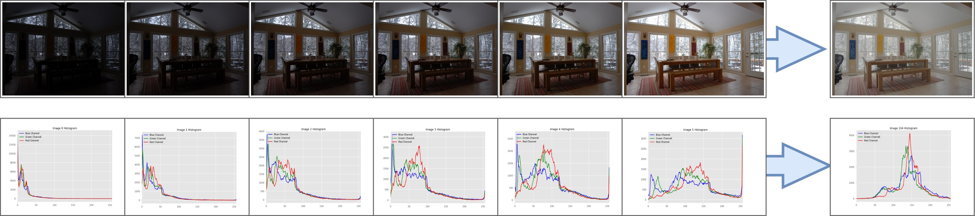
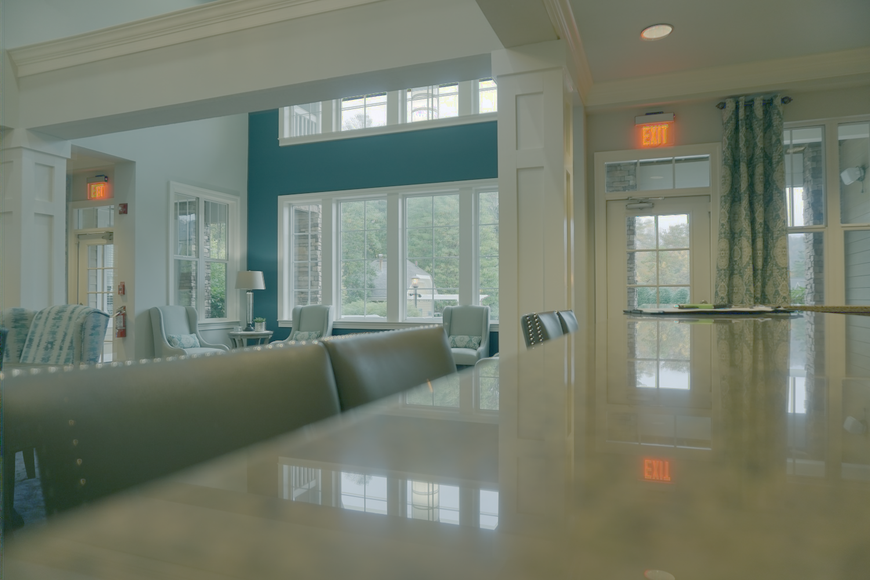
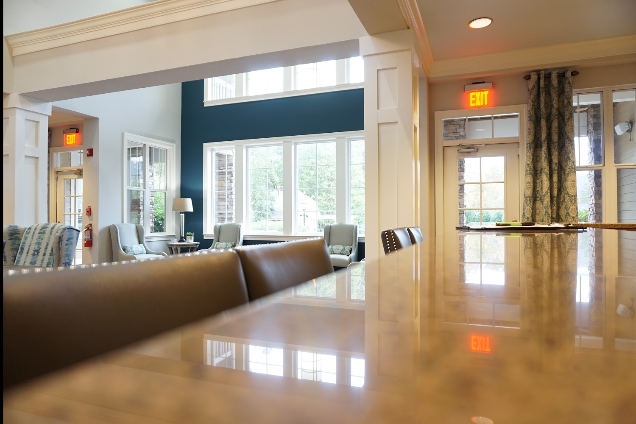
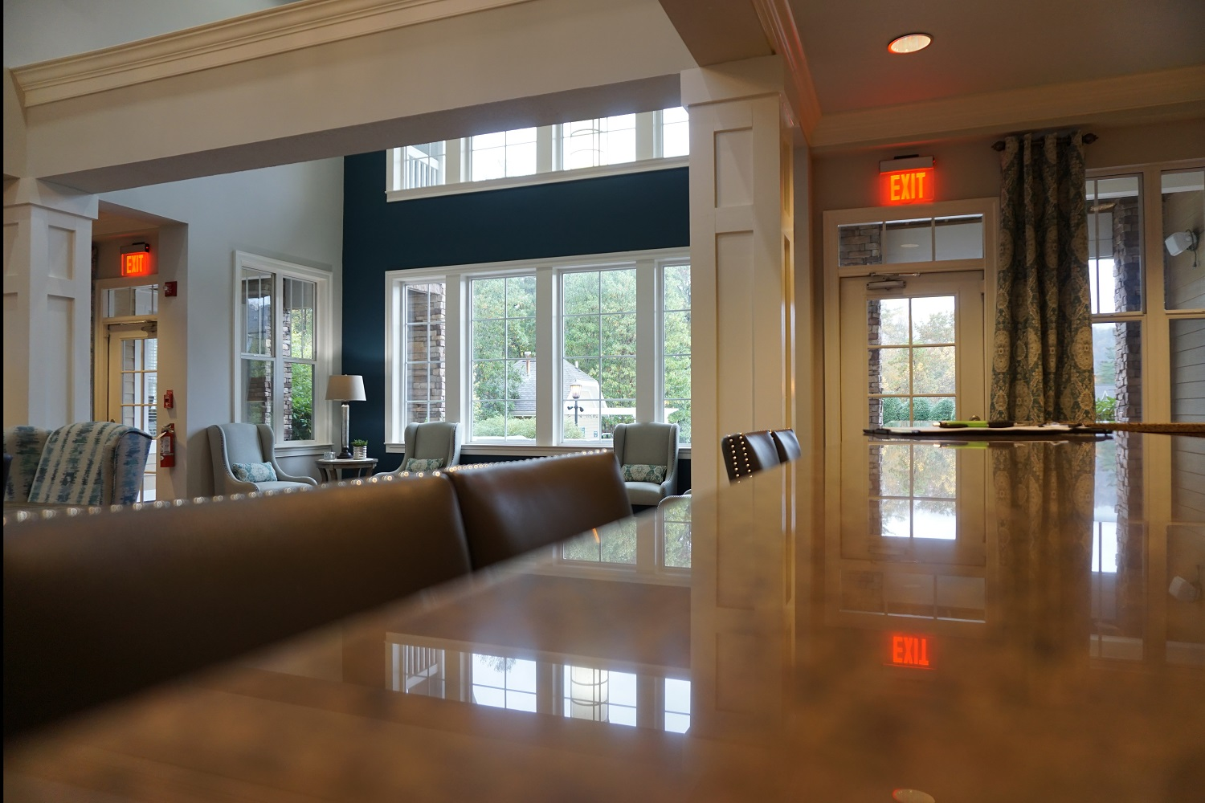
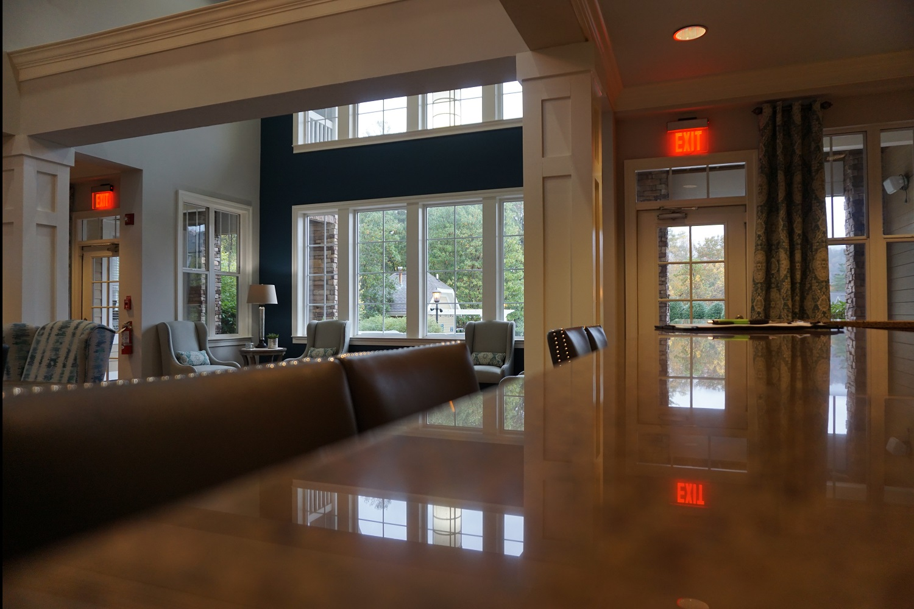

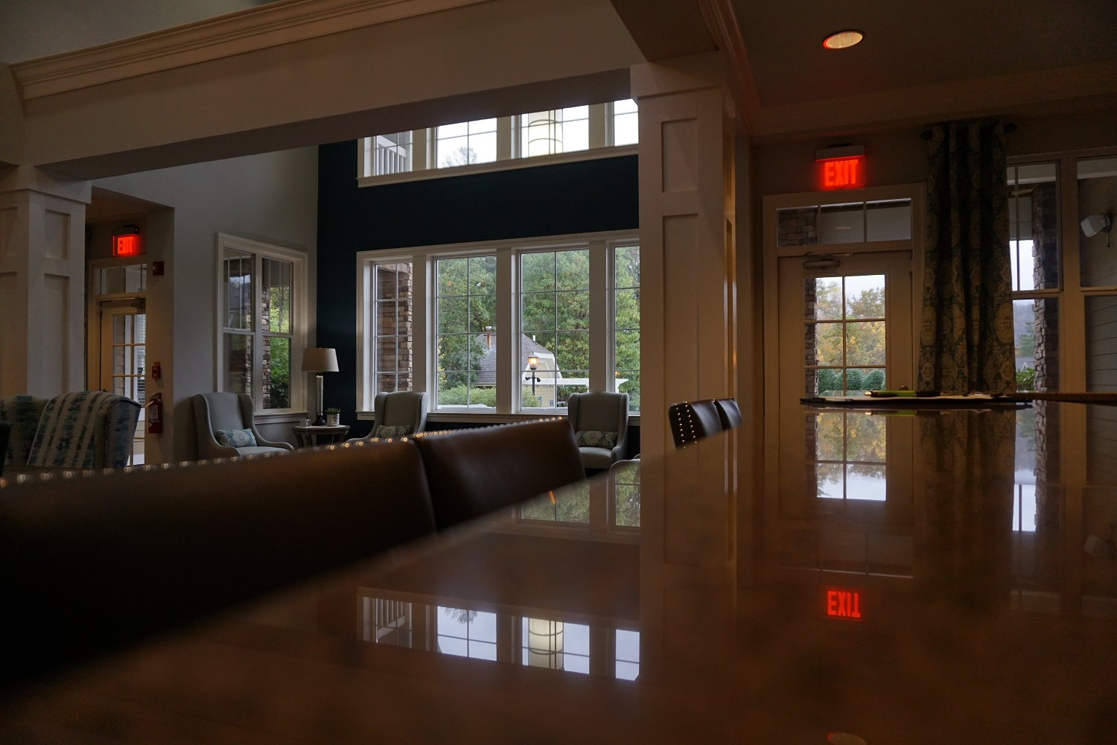
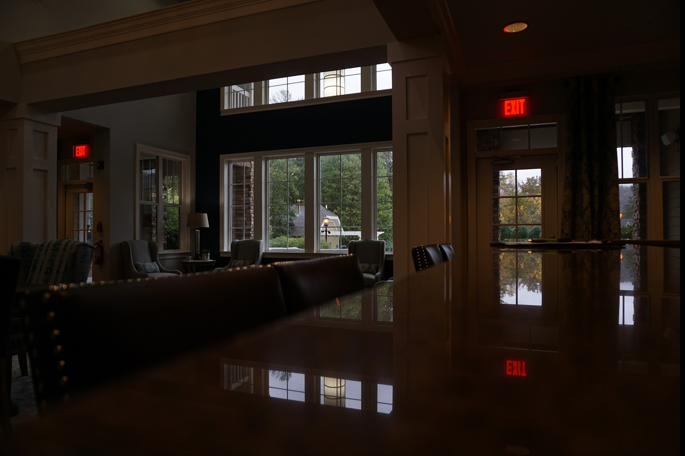
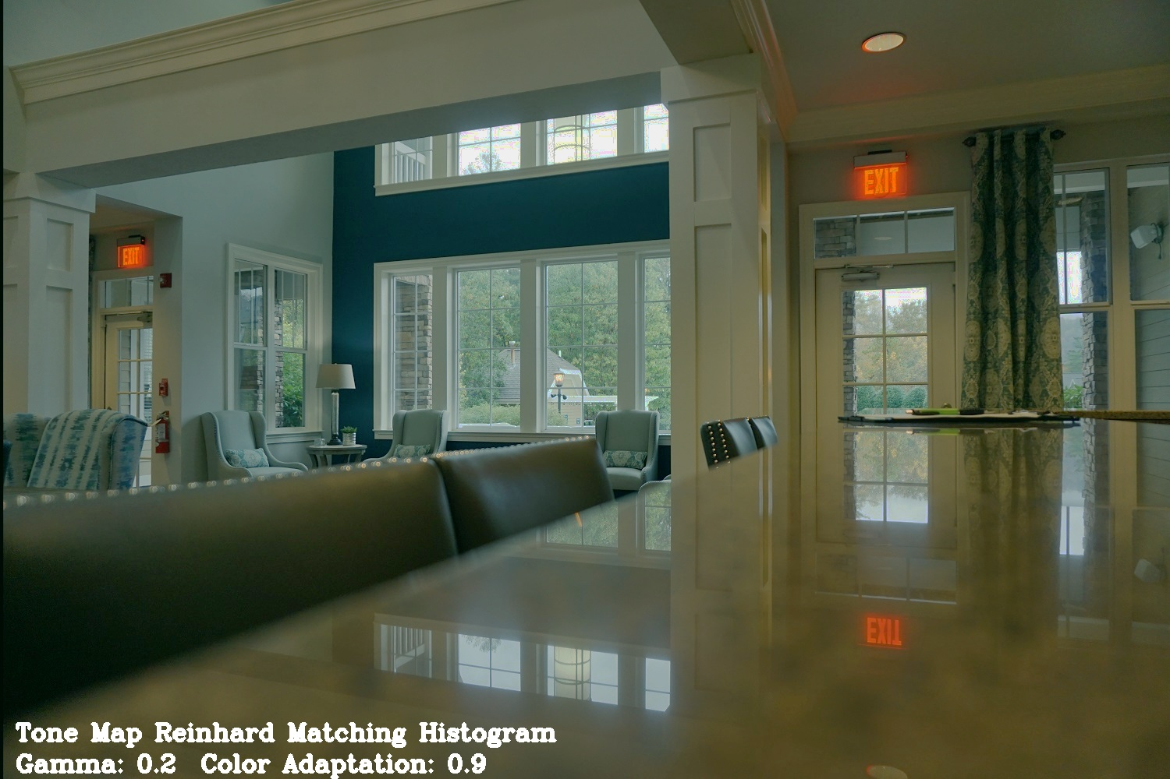
Assignment #5: HDR
Assignment 5 was to produce High Dynamic Range (HDR) images. I took my images in the office of my apartment complex. I combined them using various processing methods.
These are the resulting images. The one on the top is the result without any further processing.
This image is after applying the Reinhard color mapping algorithm.

Slide 8
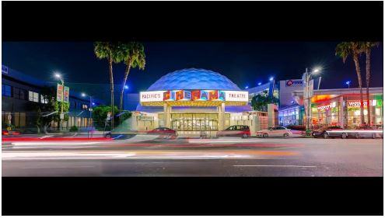
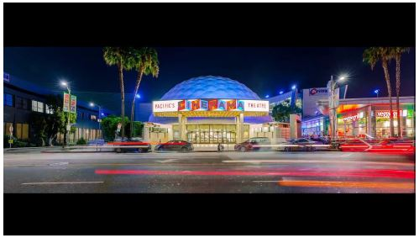
Assignment #6: Video Textures
The goal of this assignment was to produce a seamless video clip. This was done by calculating the similarity between frames and then transitioning between the most similar, which have the most frames in between them.
Here is a link to the video Reduced Size Gif

Slide 9
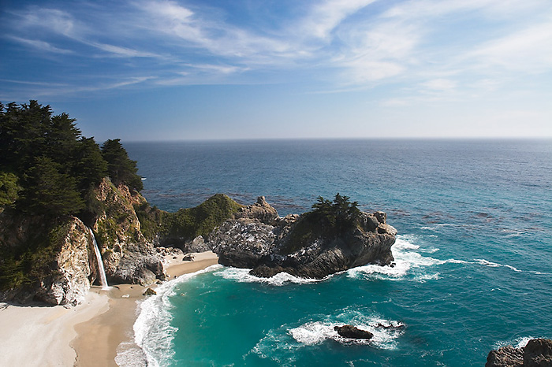
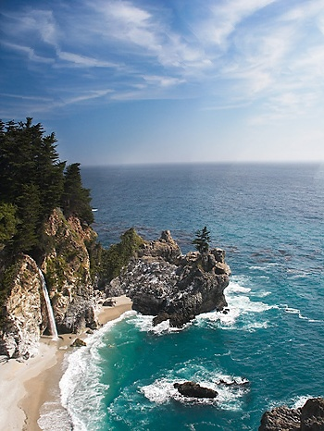
Midterm Project
The goal of the midterm project was to recreate a research paper. The topic of the paper was to introduce a way of editing or cropping an image in a smarter manor. They introduce the idea of seam-carving which is a content aware method of reducing the size of an image, while leaving most of the information still intact. This was completed by iteratively selecting the seams with the least information and removing those.

Slide 10
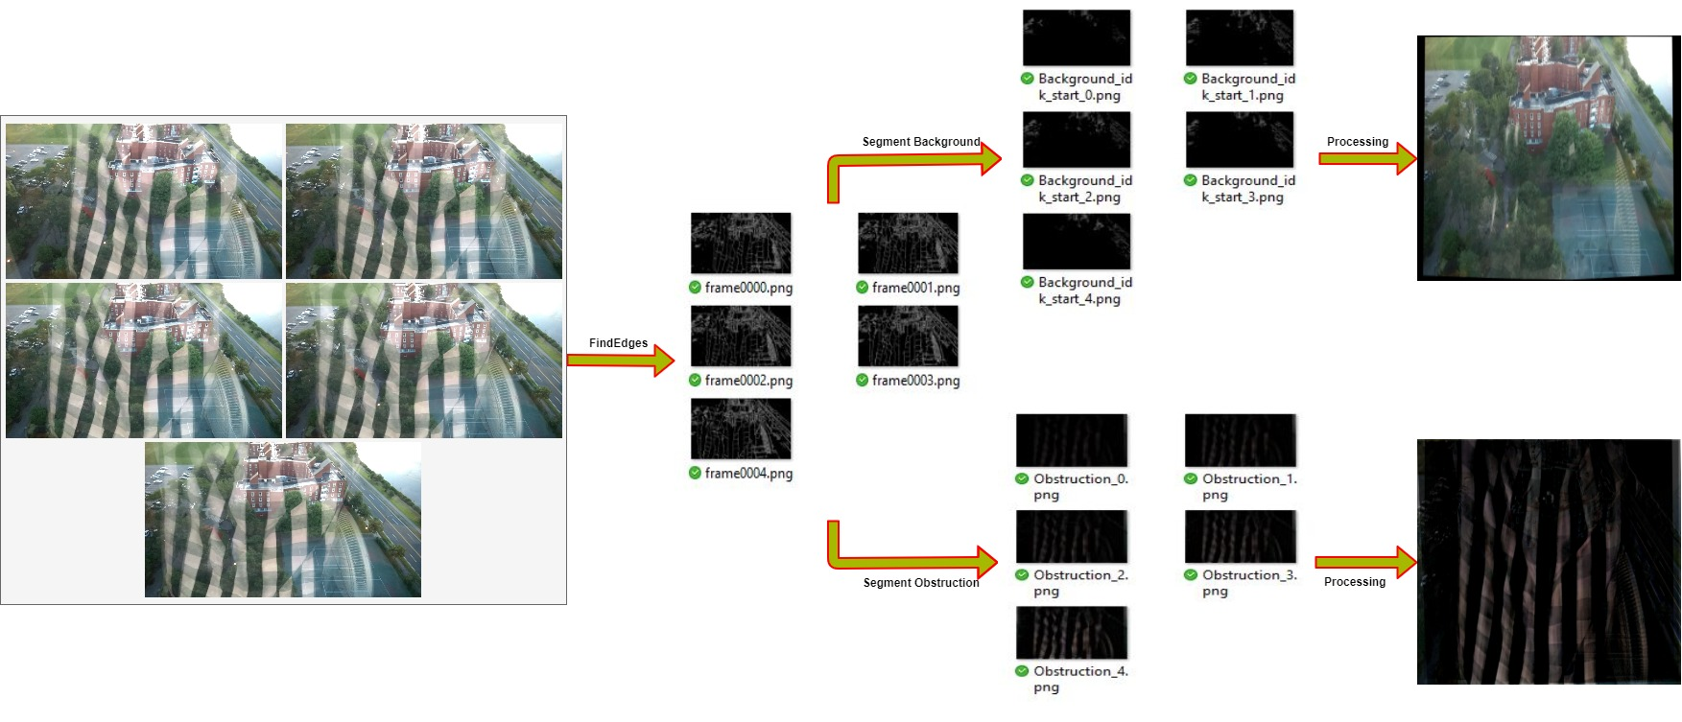
Final Project
The final project was to reproduce a research paper. The paper I chose was a method to remove obstructions from images. The process does require about 5 images in a sequence. Which are then processed into just the edges found within those images. I the calculate the edge flow between frames and then process those images to extract the obstruction and the background.

Slide 11
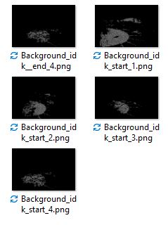
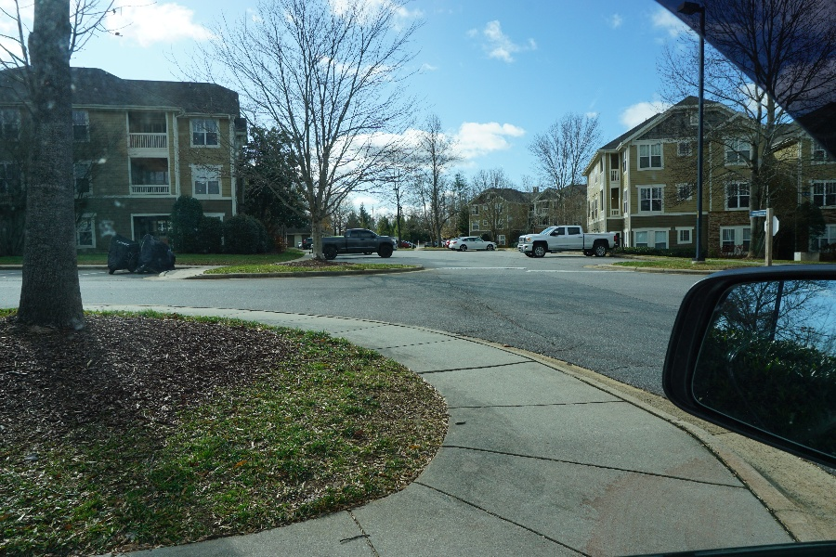
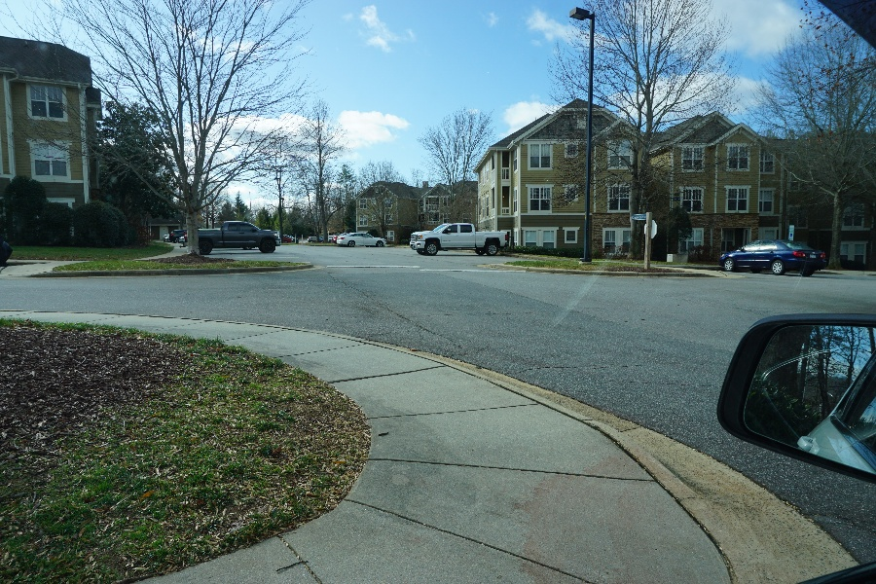
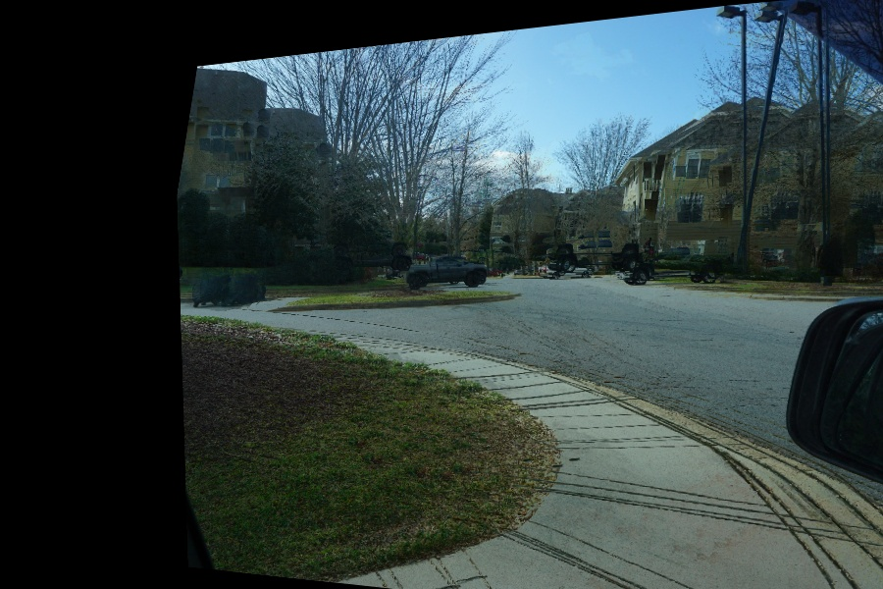
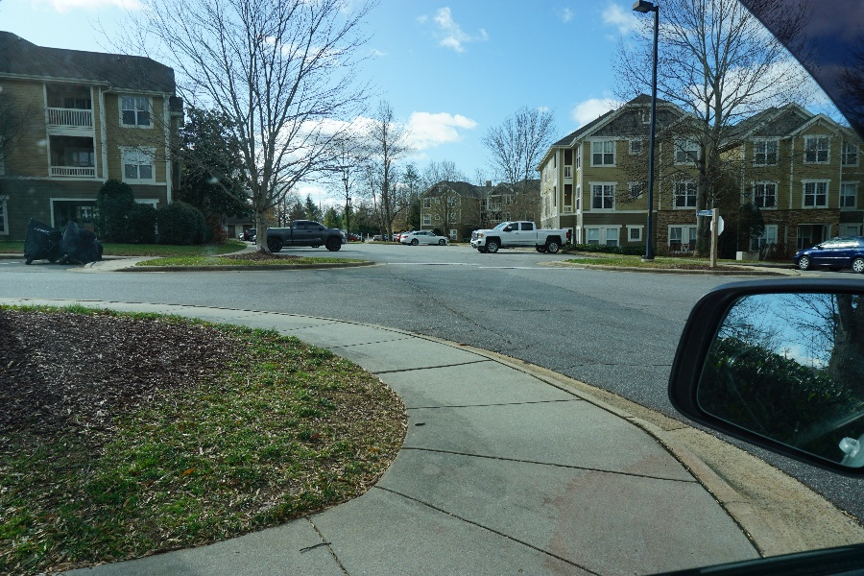
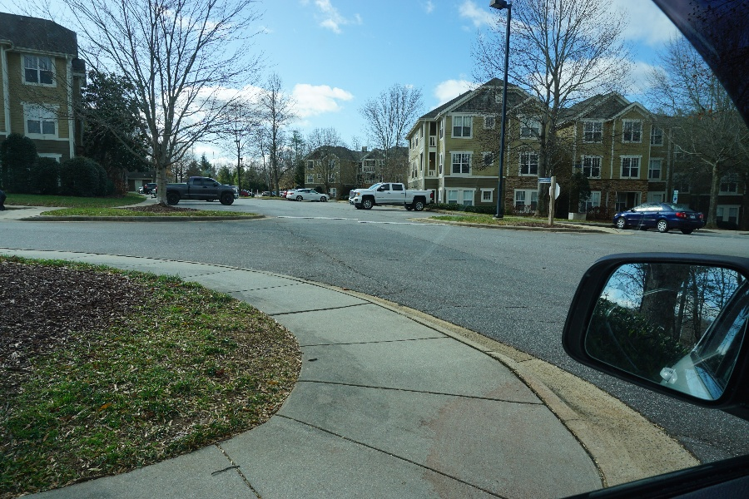
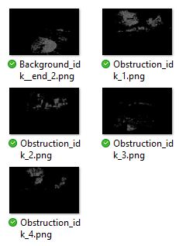
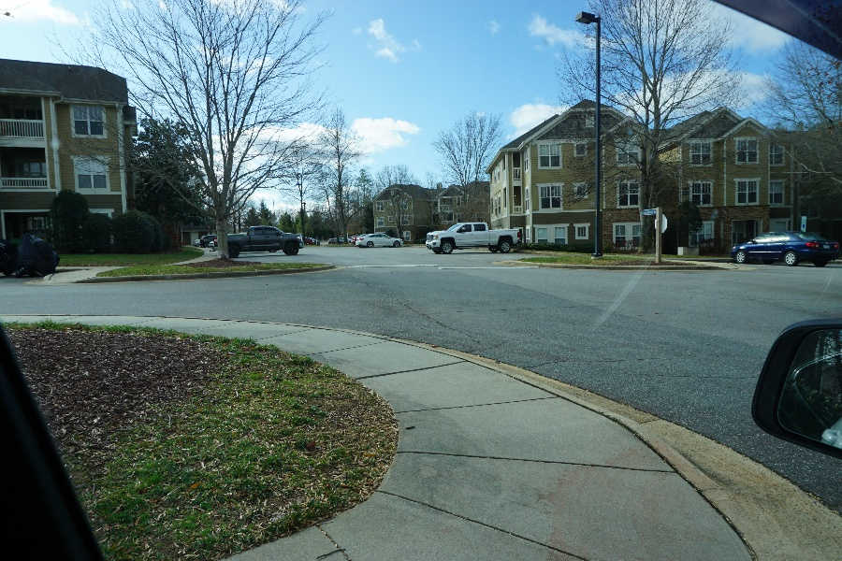
Final Project (2)

